Slide 1
doc 8.3/(1) – Amendments WIS Manual
Third Session of the Infrastructure Commission
(INFCOM-3, 15-19 April 2024)
Rémy Giraud / Chair SC-IMT
17 April 2024

Slide 2
8.3(1) Amendments To The Manual On The WIS
Amendments to the Manual on WIS
Addition of
WMO Core Metadata Profile 2.0 (WCMP2)– New standard for WIS Metadata
Discovery metadata describes a given dataset or collection
Aligning with the WIS 2.0 Principles, discovery metadata will be published to the Global Discovery Catalogue
WCMP2 is an extension of the International Standard OGC API - Records

Slide 3
8.3(1) Amendments To The Manual On The WIS Topic Hierarchy and Notification Message
Amendments to the Manual on WIS
Addition of
WIS2 Topic Hierarchy – “Backbone” of the notification architecture where the messages will be available
WIS2 Notification Message – Format of the Notification Messages
Publisher 1
Publisher 2
Publisher 3
Publish
Publish
Publish
Message Broker
Topic 1
Topic 2
Topic 3
Subscribe
Subscribe
Subscribe
User 1
User 2
User 3
Notification Message

Slide 4
WIS 2.0 topic hierarchy
Level | Name | Description
1 | channel | Location of where the data originates from (data providers [origin] or global services [cache])
2 | version | Alphabetical version of the topic hierarchy (currently a)
3 | system | Fixed value of wis2 for WIS2
4 | centre-id | Acronym as specified by member and endorsed by the PR of the country and by WMO
5 | resource-type | WIS2 resources types (data, metadata, report [from monitoring activities])
6 | data-policy | Data policy as defined by the WMO Unified Data Policy. Notifications for core and recommended data are available by subscription to Global Brokers. recommended data are downloaded from the original NC/DCPC and may require authentication/authorisation
7 | earth-system-discipline | As per Annex 1 of resolution 1 Cg-Ext-2021
8 | earth-system-discipline-category | As proposed by domain experts and further approved by INFCOM
Example:
origin/a/wis2/ca-eccc-msc/data/core/weather/ surface-based-observations/synop
cache/a/wis2/int-ecmwf/data/core/weather/prediction/forecast/medium-range/deterministic/global

Slide 5
8.3(1) Amendments To The Manual On The WIS
THE EXECUTIVE COUNCIL,
…
Recognizing the need to provide a consolidated body of technical regulations and guidance to allow the Members to prepare for the operational implementation of WIS 2.0 starting in January 2025,
Noting the successful completion of the WIS 2.0 pilot phase and the progress of the pre-operational phase,
…
Decides to adopt the amendments to the Manual on the WMO Information System provided in annex to the present resolution,
Urges Members to prepare their infrastructure and operations for the implementation of WIS 2.0 as described in the Manual on the WMO Information System and the Guide to the WMO Information System,
Requests Secretary-General to publish the amended version of the Manual on the WMO Information System in annex to the present resolution.
…
Amendments to the Manual on WIS
Addition of
WMO Core Metadata Profile 2.0 – New standard for WIS Metadata
WIS2 Topic Hierarchy – “Backbone” of the notification architecture where the messages will be available
WIS2 Notification Message – Format of the Notification Messages

Slide 6
8.3(3) Update of the Guide to the WIS
(WMO-No. 1061)

Slide 7
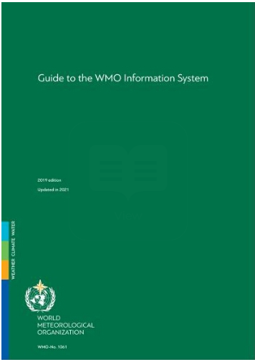
8.3(3) Update of the Guide to the WIS (WMO-No. 1061)
THE COMMISSION FOR OBSERVATION, INFRASTRUCTURE AND INFORMATION SYSTEMS,
…
Adopts the draft update of the Guide to the WMO Information System provided by the Standing Committee on Information Management and Technology and reported in the appendix to the present resolution;
Guide to the WIS split in two volumes
- Vol. I – WIS1
- Vol. II – WIS2
Critical aspect included in the Guide:
- Publishing aviation weather data from WIS 2.0 into ICAO SWIM
Guide to
WIS
Volume I
WIS 1.0
Guide to
WIS
Guide to
WIS
Volume II
WIS 2.0

Slide 8
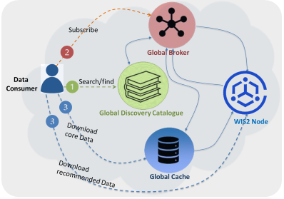
8.3(3) Update of the Guide to the WIS (WMO-No. 1061)
Information management
Security
Competencies
WIS2 Architecture
Specifications of WIS2
Implementation and operation of a WIS2 Node
WIS2 Node reference implementation: wis2box
Implementation and operation of a Global Service
Procedure for registration of a new Global Service
How to subscribe to notifications about the availability of new data
How to use a notification message to decide whether to download data
How to download data
How to use data
How to provide data to WIS2
WIS 2.0
Interoperability with external systems
WHOS
OpenCDMS
Cryosphere
Weather Ocean
Hydrology data sharing
Data management and data sharing for climate
Data sharing for the cryosphere community
Data sharing for the weather and ocean

Slide 9
GUIDE TO WMO INFORMATION SYSTEM VOLUME II
PART I
1.1. Introduction to WIS2
PART II
2.1. WIS2 Architecture
PART III
3.1. Information management
3.1.1. Introduction
3.1.2. Principles of information management
3.1.3. The information management lifecycle
3.1.4. Other considerations
PART IV & PAR V
4.1. Security
5.1. Competencies
1.1.1. Leveraging open standards
1.1.2. Simpler data exchange
1.1.3. Cloud-ready solutions
1.1.4. Why are datasets so important?
1.2. Data consumer
1.2.1. How to search the Global Discovery Catalogue to find Datasets
1.2.2. How to subscribe to notifications about availability of new data
1.2.3. How to use a notification message to decide whether to download data
1.2.4. How to download data
1.2.5. How to use data
1.2.6. Further reading for data consumers
1.3. Data publisher
1.3.1. How to get started
1.3.2. How to provide discovery metadata to WIS2
1.3.3. How to provide data to WIS2
1.3.4. Further reading for data publishers
2.2. Roles in WIS2
2.2.1. Data Publisher
2.2.2. Global Coordinator
2.2.3. Global Service operator
2.2.4. Data Consumer
2.3. Specifications of WIS2
2.4. Components of WIS2
2.4.1. WIS2 Node
2.4.2. Global Broker
2.4.3. Global Cache
2.4.4. Global Discovery Catalogue
2.4.5. Global Monitor
2.5. Protocols configuration
2.5.1. Publish-Subscribe protocol (MQTT)
2.5.2. Download protocol (HTTP)
2.6. Implementation and operation of a WIS2 Node
2.6.1. Practices and procedures
2.6.2. Performance management
2.6.3. WIS2 Node reference implementation: wis2box
2.7. Implementation and operation of a Global Service
2.7.1. Procedure for registration of a new Global Service
2.7.2. Performance management and monitoring of a Global Service
2.7.3. Global Broker
2.7.4. Global Cache
2.7.5. Global Discovery Catalogue
2.7.6. Global Monitor
2.8. Operations
2.8.1. Interoperability with external systems

Slide 10
Thank you.
^{wmo.int}

Slide 11
Doc 8.3(1) Amendments to the Manual on the WIS Annex to EC Resolution - Draft2
APPENDIX F: WMO CORE METADATA PROFILE (VERSION 2)
…
2 WMO Core Metadata Profile resources
2.1 WMO Codes Registry
http://codes.wmo.int/wis/topic-hierarchy/centre-id
http://codes.wmo.int/wis/topic-hierarchy/earth-system-discipline
http://codes.wmo.int/wis/topic-hierarchy/data-policy
http://codes.wmo.int/wis/link-type
http://codes.wmo.int/wis/contact-role
2.2 WMO schemas server
Validation, examples and other resources are published at https://schemas.wmo.int/wcmp.[Secretariat]

Slide 12
Doc 8.3(1) Amendments to the Manual on the WIS Annex to EC Resolution - WiP
APPENDIX E: WIS2 NOTIFICATION MESSAGE
…
1.14 Properties / Content
The content property allows for the inclusion of data in the notification message when the encoded data length of the data, once encoded, is smaller than 4096 bytes. The limit considers the data encoding. That is, if the data are encoded in a form that changes the size, the resulting size must be less than 4096 bytes. [Russian Federation]

Slide 13
Doc 8.3(1) Amendments to the Manual on the WIS Annex to EC Resolution - WiP
APPENDIX E: WIS2 NOTIFICATION MESSAGE
…
1.12 Properties / Cache
All cCore data, by default, is cached by Global Cache services as described in the Guide to the WMO Information System (WMO-NO. 1061)[Japan]

Slide 14
Doc 8.3(1) Amendments to the Manual on the WIS Annex to EC Resolution - WiP
Requests INFCOM to closely monitor and examine the performance of WIS 2.0 during its pre-operational and operational phases to further refine the functions and technical specifications of the Global Services, responding to the expansion of core data, and report it back to INFCOM-4; [Japan]

